Slide 1


WOMEI ANGELBEL TOHBI
22-01-2023

Slide 2

Outline
Executive Summary
Introduction
Methodology
Insights Drawn From E.D.A
Launch Sites Proximities
Dashboard
Predictive Analytics
Results
Conclusion
Appendix

Slide 3
Executive Summary
Summary of methodologies
- Data collection
- Data wrangling
- Exploratory Data Analysis with Data Visualization
- Exploratory Data Analysis with SQL
- Building an interactive map with Folium
- Building a Dashboard with Plotly Dash
- Predictive analysis (Classification)
Summary of all results
- Exploratory Data Analysis results
- Interactive analytics demo in screenshots
- Predictive analysis results

Slide 4
Introduction
The primary objective of this Data Science project is to allow the company to compete with SpaceX. In order to achieve this goal, it is necessary to predict if the first stage of the SpaceX Falcon 9 rocket will land successfully.
SpaceX advertises Falcon 9 rocket launches on its website, with a cost of 62 million dollars. Other providers cost upward of 165 million dollars each, much of the savings is because SpaceX can reuse the first stage.
Therefore if we can accurately predict the likelihood of the first stage rocket landing successfully, we can determine the cost of a launch. With the help of the Data Science findings and models, the company can make more informed bids against SpaceX for a rocket launch.

Slide 5

Section 1

Slide 6
Methodology
Executive Summary
Data collection methodology:
Data was collected using SpaceX API and web scraping from Wikipedia.
Perform data wrangling
One-hot encoding was applied to categorical features
Perform exploratory data analysis (EDA) using visualization and SQL
Perform interactive visual analytics using Folium and Plotly Dash
Perform predictive analysis using classification models
How to build, tune, evaluate classification models

Slide 7
Data Collection
Data collection process involved a combination of API requests from SpaceX REST API and Web Scraping data from a table in SpaceX’s Wikipedia entry. We had to use both of these data collection methods in order to get complete information about the launches for a more detailed analysis. Data Columns are obtained by using SpaceX REST API: FlightNumber, Date, BoosterVersion, PayloadMass, Orbit, LaunchSite, Outcome, Flights, GridFins, Reused, Legs, LandingPad, Block, ReusedCount, Serial, Longitude, Latitude Data Columns are obtained by using Wikipedia Web Scraping: Flight No., Launch site, Payload, PayloadMass, Orbit, Customer, Launch outcome, Version Booster, Booster landing, Date, Time Data collection – SpaceX API Requesting rocket launch data from SpaceX API Decoding the response content using .json() and turning it into a dataframe using .json_normalize()

Slide 8

Data Collection – SpaceX API
I used the get request to the SpaceX API to collect data, clean the requested data and did some basic data wrangling and formatting.
GitHub URL:Data collection - spaceXAPI
Place your flowchart of SpaceX API calls here

Slide 9

Data Collection - Scraping
I applied web scrapping to obtain Falcon 9 launch records with BeautifulSoup.
I parsed the table and converted it into a pandas dataframe.
GitHub URL:Data collection-webscraping
Place your flowchart of web scraping here

Slide 10

Data Wrangling
I performed exploratory data analysis and determined the training labels.
I calculated the number of lunches at each site , and the number of occurrence of each orbits.
I created landing outcome label from column and exported the result to CSV.
GitHub URL:Data wrangling

Slide 11
EDA with Data Visualization
Charts were plotted: Flight Number vs. Payload Mass, Flight Number vs. Launch Site, Payload Mass vs. Launch Site, Orbit Type vs. Success Rate, Flight Number vs. Orbit Type, Payload Mass vs Orbit Type and Success Rate Yearly Trend Scatter plots show the relationship between variables. If a relationship exists, they could be used in machine learning model. Bar charts show comparisons among discrete categories. The goal is to show the relationship between the specific categories being compared and a measured value. Line charts show trends in data over time (time series).
GitHub URL:EDA with Data visualisation

Slide 12
EDA with SQL
Summary of SQL queries that were used:
Display the names of the unique launch sites in the space mission.
Compare the payload mass with boosters launched by NASA (CRS).
Display average payload mass carried by booster version F9 v1.1.
List the total number of successful and failure mission outcomes.
Determine the dates of different landing outcomes
GitHub URL:EDA SQL

Slide 13
Build an Interactive Map with Folium
Folium Markers were used to show the SpaceX launch sites and their nearest important landmarks like railways, highways, cities and coastlines.
Polylines were used to connect the launch sites to their nearest land marks.
Furthermore, Folium Circles were used to highlight circle area of launch sites.
• In order to mark the success/failed launches for each site, marker clusters were used on the map. Whereby Red represents rocket launch failures while Green represents the successes.
GitHub URL:Interactive map with Folium

Slide 14
Build a Dashboard with Plotly Dash
Pie charts and scatter charts were used to visualize the launch records of SpaceX
These charts displayed the rocket launch success rate per launch site. We are were able to get an understanding of the factors that may have been influencing the success rate at each site. Such as the payload mass and booster versions
Successful launches were represented by 1 while failures were represented by 0
GitHub URL:DASHBOARD WITH PLOTLY DASH

Slide 15
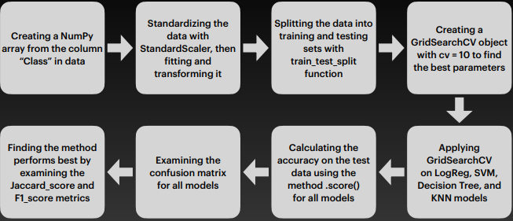
Predictive Analysis (Classification)
Scikit-learn is the primary ML(machine learning) library that was used for predictive analysis. The following took place:
Created a machine learning pipeline to predict if the first stage will land given the data.
Using GridSearchCV, found the best ML method for predictions.
Compared the predictions with the real labels.
he ML model scored an accuracy of 83.33%
GitHub URL:spacex machine learning

Slide 16
Results
The exploratory data analysis has shown us that successful landing outcomes are somewhat correlated with flight number. It was also apparent that successful landing outcomes have had a significant increase since the year 2015.
All launch sites are located near the coast line. Perhaps, this makes it easier to test rocket landings in the water.
Furthermore, the sites are also located near highways and railways. This may facilitate transportation of equipment and research material.
The machine learning models that were built, were able to predict the landing success of rockets with an accuracy score of 83.33%. This accuracy can be increased in future projects with more data.

Slide 17

Section 2

Slide 18
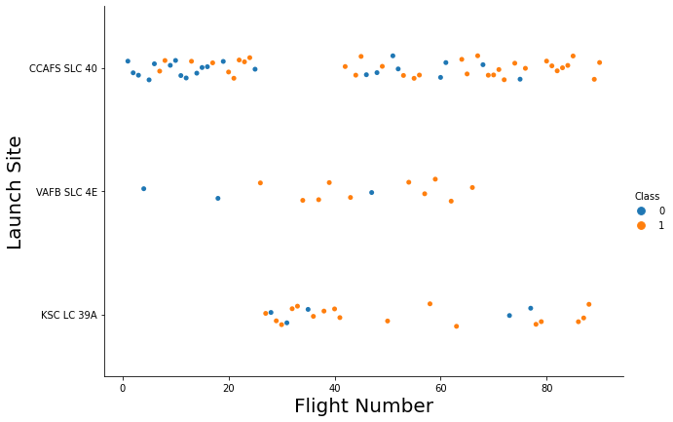
Flight Number vs. Launch Site
From the plot, we found that the larger the flight amount at a launch site, the greater the success rate at a launch site.

Slide 19
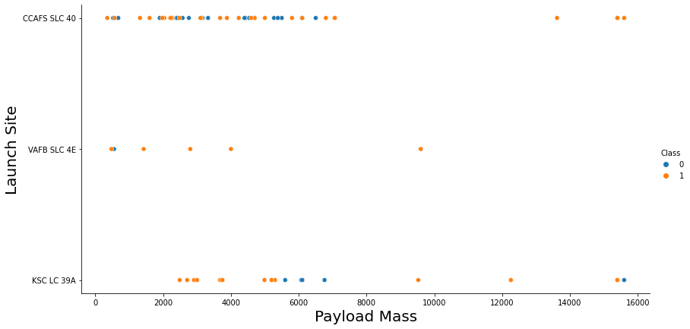
Payload vs. Launch Site
The blue dots represent the successful launches while the red dots represent unsuccessful launches.
For the VAFB-SLC launchsite there are no rockets launched for heavy payload mass
There seems to be a weak correlation between Payload and Launch Site and therefore decisions cannot be made using this metric.

Slide 20
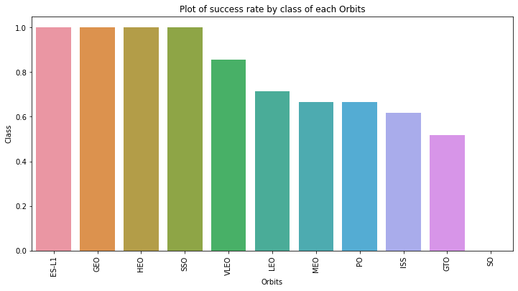
Success Rate vs. Orbit Type
The orbit types SSO, HEO, GEO and ES-L1 had the highest success rate.

Slide 21
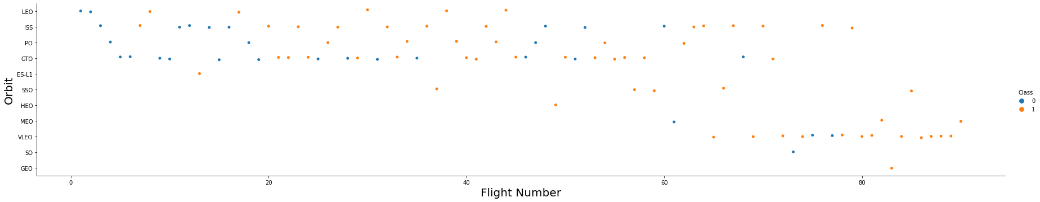
Flight Number vs. Orbit Type
The plot below shows the Flight Number vs. Orbit type. I observe that in the LEO orbit, success is related to the number of flights whereas in the GTO orbit, there is no relationship between flight number and the orbit.

Slide 22

Payload vs. Orbit Type
I observed that with heavy payloads, the successful landing are more for PO, LEO and ISS orbits.

Slide 23
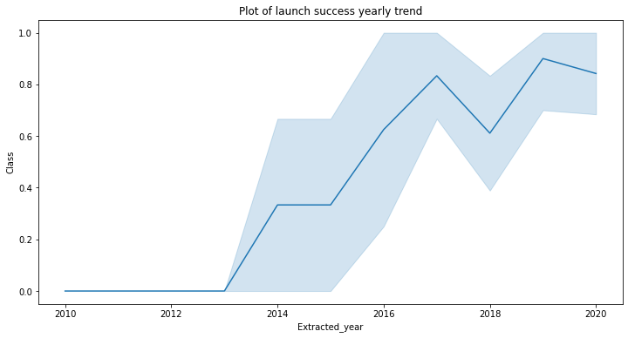
Launch Success Yearly Trend
From the plot,I observed that the success rate since 2013 kept on increasing till 2020.

Slide 24

All Launch Site Names
I used the key word DISTINCT to show only unique launch sites from the SpaceX data.

Slide 25

Launch Site Names Begin with 'CCA'
I used the query above to display 5 records where launch sites begin with `CCA`

Slide 26
Total Payload Mass
The information in the table displays the total payload mass carried by boosters launched by NASA .
It seems that NASA (CRS) had a significantly higher total payload mass compared to the rest.
Customer | Total_Payload_Mass
NASA (CRS) | 45596
NASA (CCDev) | 12530
NASA (CCP) | 12500
NASA (CCD) | 12055
NASA (CTS) | 12050
NASA (CRS), Kacific 1 | 2617
NASA / NOAA / ESA / EUMETSAT | 1192
NASA (LSP) NOAA CNES | 553
NASA (COTS) | 525
NASA (LSP) | 362
NASA (COTS) NRO | 0

Slide 27

Average Payload Mass by F9 v1.1
I calculated the average payload mass carried by booster version F9 v1.1 as 2928.4

Slide 28

First Successful Ground Landing Date
Using the min(date) function,I observed that the dates of the first successful landing outcome on ground pad was 22nd December 2015

Slide 29

Successful Drone Ship Landing with Payload between 4000 and 6000
I used the WHERE clause to filter for boosters which have successfully landed on drone ship and applied the AND condition to determine successful landing with payload mass greater than 4000 but less than 6000

Slide 30

Total Number of Successful and Failure Mission Outcomes
I used the wildcard like ‘%’ to filter for WHERE MissionOutcome was a success or a failure.

Slide 31

Boosters Carried Maximum Payload
I determined the booster that have carried the maximum payload using a subquery in the WHERE clause and the MAX() function.

Slide 32

2015 Launch Records
I used a combinations of the WHERE clause, LIKE, AND, and BETWEEN conditions to filter for failed landing outcomes in drone ship, their booster versions, and launch site names for year 2015

Slide 33

Rank Landing Outcomes Between 2010-06-04 and 2017-03-20
I selected Landing outcomes and the COUNT of landing outcomes from the data and used the WHERE clause to filter for landing outcomes BETWEEN 2010-06-04 to 2010-03-20.
I also applied the GROUP BY clause to group the landing outcomes and the ORDER BY clause to order the grouped landing outcome in descending order.

Slide 34

Section 3

Slide 35
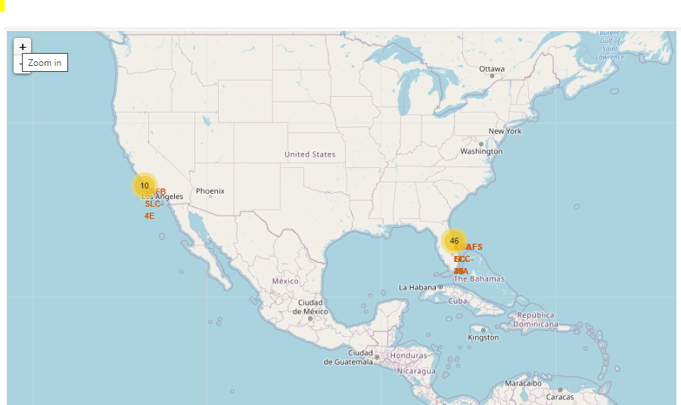
All launch sites’ location markers on a global map
Explanation:
• Most of Launch sites are in proximity to the Equator line. The land is moving faster at the equator than any other place on the surface of the Earth. Anything on the surface of the Earth at the equator is already moving at 1670 km/hour. If a ship is launched from the equator it goes up into space, and it is also moving around the Earth at the same speed it was moving before launching. This is because of inertia. This speed will help the spacecraft keep up a good enough speed to stay in orbit.

Slide 36
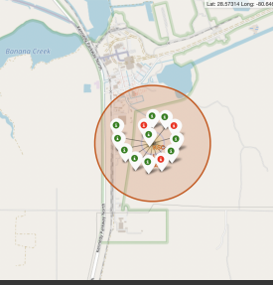
Colour-labeled launch records on the map
Explanation:
Explanation: • From the colour-labeled markers we should be able to easily identify which launch sites have relatively high success rates.
Green Marker = Successful Launch
Red Marker = Failed Launch
Launch Site KSC LC-39A has a very high Success Rate

Slide 37
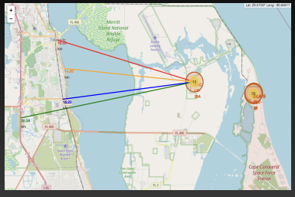
Distance from the launch site KSC LC-39A to its proximities
From the visual analysis of the launch site KSC LC-39A I can clearly see that it is:
close to railway (15.23 km)
close to highway (20.28 km)
close to coastline (14.99 km)
Also the launch site KSC LC-39A is relative close to its closest city Titusville (16.32 km

Slide 38

Section 4

Slide 39

Pie chart showing the success percentage achieved by each launch site

Slide 40

Pie chart showing the Launch site with the highest launch success ratio

Slide 41

Scatter plot of Payload vs Launch Outcome for all sites, with different payload selected in the range slider

Slide 42

Section 5

Slide 43
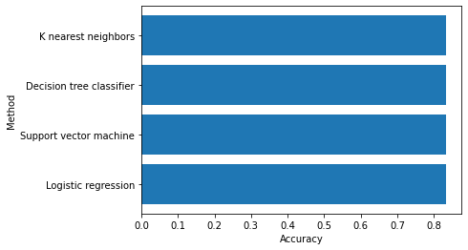
Classification Accuracy
• Since all the methods have an identical accuracy score of 83.33%, I decided to use Logistic Regression for the classification

Slide 44
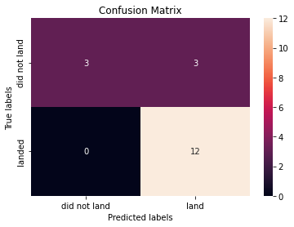
Confusion Matrix
I noticed that the confusion matrix for the decision tree classifier shows that the classifier can distinguish between the different classes. The major problem is the false positives .i.e., unsuccessful landing marked as successful landing by the classifier.

Slide 45
Conclusions
I can conclude that:
• All their launch sites are located near the coast, away from nearby cities. This enabled them to test their rocket landings without much interference.
• Orbits ES-L1, GEO, HEO, SSO, VLEO had the most success rate.
• KSC LC-39A had the most successful launches of any sites.
• Launch success rate started to increase in 2013 till 2020.
• All these data was used to train a machine learning model that is able to predict the landing outcome of rocket launches with 83.33% accuracy.

Slide 46
Appendix
Include any relevant assets like Python code snippets, SQL queries, charts, Notebook outputs, or data sets that you may have created during this project

Slide 47


